Slide 1
2018 SEC Academic Conference Cyber Security: A Shared Responsibility SEC Student Cyber Challenge
The University of Mississippi

Slide 2
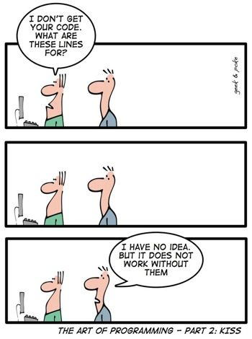
Meet the Team
Advisor: Jeff Lucas
Students:
Mark Garrett
Junior, Computer Science
Aish Ghimire
Junior, Computer Science
Jonathon Guin
Senior, Management Information Systems
Doron Reinsager
Junior, Computer Science
Laura Ann Salvador
Junior, Management Information Systems
John Cody Wilkinson
Senior, Computer Science

Slide 3

Agenda
Challenge
Solution
Test & Integration Plan
Take-Aways
1.
Create a Website
2.
Create a Database
3.
Use AWS
4.
Security Policy

Slide 4

Challenge
Data, like any raw material, has a supply chain and a life cycle. Your challenge is to take your cyber knowledge and principles to create a policy-based approach that centers around the sensitive data itself and not only its environment. For example, a patient has a 10mg prescription for their heart medication and the database is altered to 100mg.
What happens when data is accessed or changed?
Is the change authorized?
Who should know about these changes?
What are the actions to these changes to be put in place?

Slide 5

Solution
RebelBanking, 1234 University Ave., Oxford, MS 38655
A secure way to manage your money.
Security Features:
Public and private key encryption
Notifications every time your account is accessed
Fault tolerance

Slide 6
Step 1. Create a Website
See for yourself! Click through our site.
Example Credentials:
Username: Amy1
Password: OleMiss1!

Slide 7
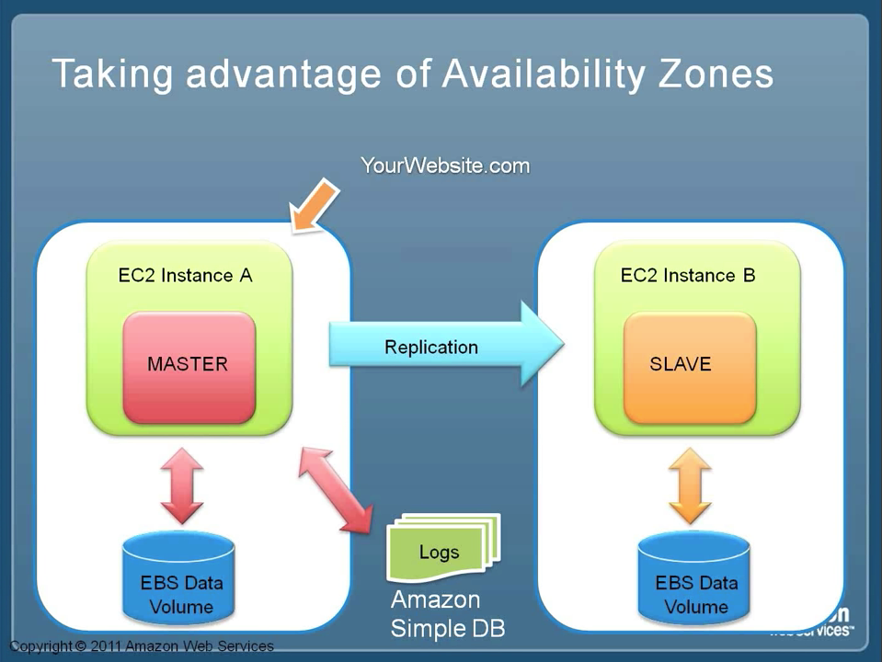
Development Environment
Room 2116
Software: Trello, Github, AWS, Visual Studio Code, Chrome
Hardware: 6 Laptops, 1 iPad, HDMI Cord
Data Set: 2 Administrators, 6 Employees, 12 Clients

Slide 8
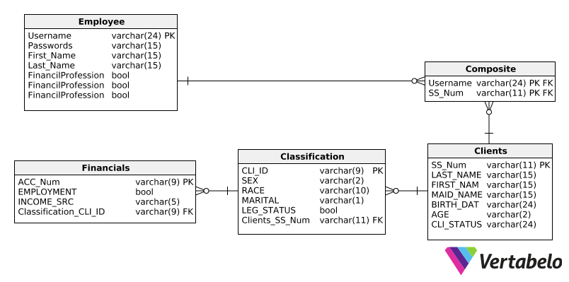
Step 2. Create a Database

Slide 9

Step 3. Amazon Web Services
Create a Virtual Environment using EC2
Use public and private key pair encryption to access the EC2
Create user accounts to connect to the Virtual Environment and transfer data using SSH
Employ RDS to use MySQL with PHPMyAdmin
Put the website in a secure server using HTTPS by creating a SSL Certificate for Apache in Ubuntu

Slide 10
4. Security Policy
At RebelBanking we take security seriously. That’s why we have automated notifications for every time your account is accessed. That’s why we encrypt everything. That’s why we designed our site on a secure server. That’s why we do everything the way we do.
For your safety, and your data’s security.

Slide 11
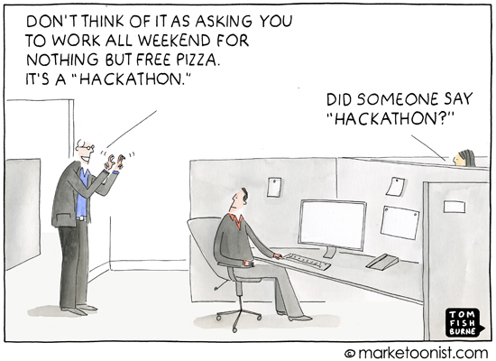
Take-Aways
Had we had more time…
We would have liked to further test our website and database connectivity
Things we learned:
Learn PHP ASAP
Expect the unexpected
Plan website layout before jumping in
Thank you for having us!

